Slide 1
Interface is look like a class but it is not a class
An interface in Java is a blueprint of a class.
It has static constants and abstract methods.
The interface in Java is a mechanism to achieve abstraction.
There can be only abstract methods in the Java interface, not method body.
It is used to achieve abstraction and multiple inheritance in Java.
In other words, you can say that interfaces can have abstract methods and variables. It cannot have a method body.

Slide 2
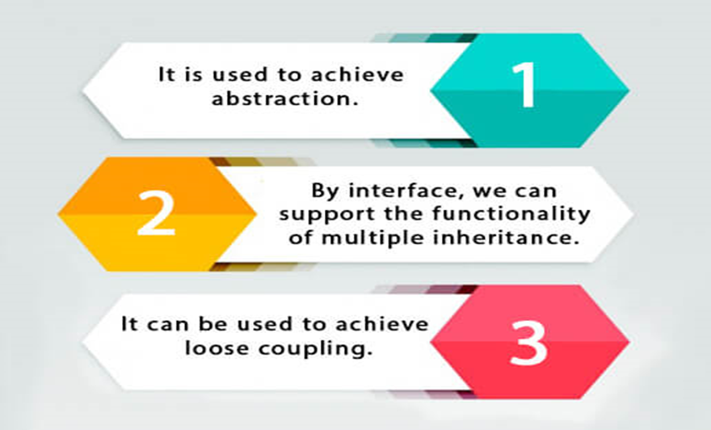
Why use Java interface?

Slide 3
How to declare an interface?
An interface is declared by using the interface keyword. It provides total abstraction;
It means all the methods in an interface are declared with the empty body, and all the fields are public, static and final by default.
A class that implements an interface must implement all the methods declared in the interface.
Syntax:
interface <interface_name>
{
// declare constant fields
// declare methods that abstract
// by default.
}

Slide 4
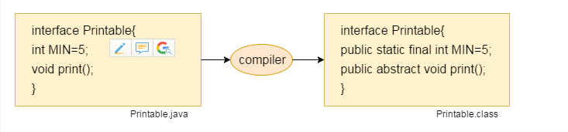

Slide 5
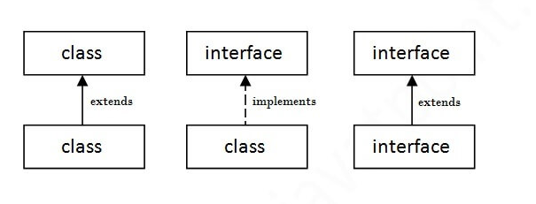
The relationship between classes and interfaces

Slide 6
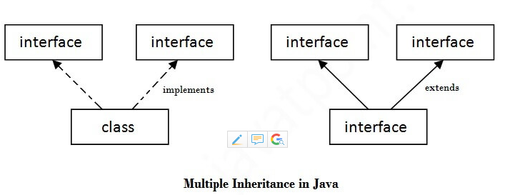
Multiple inheritance in Java by interface
If a class implements multiple interfaces, or an interface extends multiple interfaces, it is known as multiple inheritance.

Slide 7
interface Printable{
void print();
}
interface Showable{
void show();
}
class A7 implements Printable,Showable
{
public void print()
{
System.out.println("Hello");
}
public void show(){
System.out.println("Welcome");
}
public static void main(String args[])
{
A7 obj = new A7();
obj.print();
obj.show();
}
}
Output: Hello
Welcome

Slide 8
Interface inheritance
A class implements an interface, but one interface extends another interface.
EXAMPLE
interface Printable
{
void print();
}
interface Showable extends Printable
{
void show();
}
class TestInterface4 implements Showable
{
public void print()
{
System.out.println("Hello");
}
public void show()
{
System.out.println("Welcome");
}
public static void main(String args[])
{
TestInterface4 obj = new TestInterface4();
obj.print();
obj.show();
}
}
Output:
Hello
Welcome

Slide 9
New Features Added to Interfaces in JDK 8
There are certain features added to Interfaces in JDK 8 update mentioned below:
Default interface methods
Static methods in an interface

Slide 10
Default interface methods
With the release of Java 8, we can now add methods with implementation inside an interface. These methods are called default methods.
To declare default methods inside interfaces, we use the default keyword.
Default methods are also known as defender methods or virtual extension methods.
For example,
public default void getSides()
{
// body of getSides()
}

Slide 11
interface Polygon {
void getArea();
// default method
default void getSides() {
System.out.println("I can get sides of a polygon.");
}
}
// implements the interface
class Rectangle implements Polygon {
public void getArea() {
int length = 6;
int breadth = 5;
int area = length * breadth;
System.out.println("The area of the rectangle is " + area);
}
// overrides the getSides()
public void getSides() {
System.out.println("I have 4 sides.");
}
}
// implements the interface
class Square implements Polygon {
public void getArea() {
int length = 5;
int area = length * length;
System.out.println("The area of the square is " + area);
}
}
class Main {
public static void main(String[] args) {
// create an object of Rectangle
Rectangle r1 = new Rectangle();
r1.getArea();
r1.getSides();
// create an object of Square
Square s1 = new Square();
s1.getArea();
s1.getSides();
}
}

Slide 12
static Methods in Interface
The Java 8 also added another feature to include static methods inside an interface.
Similar to a class, we can access static methods of an interface using its references.
The static methods in interfaces are similar to default methods but the only difference is that you can’t override them.
Now, why do we need static methods in interfaces if we already have default methods?
Suppose you want to provide some implementation in your interface and you don’t want this implementation to be overridden in the implementing class, then you can declare the method as static.

Slide 13
static Methods in Interface
class TestClass implements TestInterface
{
// Implementation of square abstract method
public void square (int a)
{
System.out.println(a*a);
}
public static void main(String args[])
{
TestClass d = new TestClass();
d.square(4);
// Static method executed
TestInterface.show();
}
}
// A simple Java program to TestClassnstrate static
// methods in java
interface TestInterface
{
// abstract method
public void square (int a);
// static method
static void show()
{
System.out.println("Static Method Executed");
}
}

Slide 14
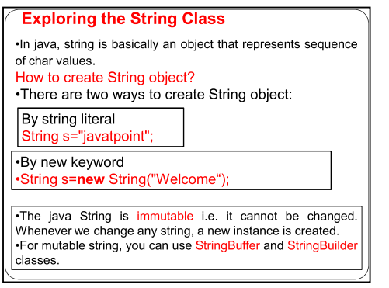

Slide 15
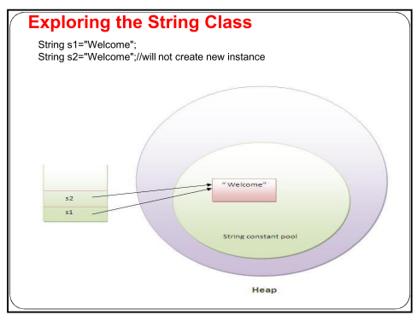

Slide 16
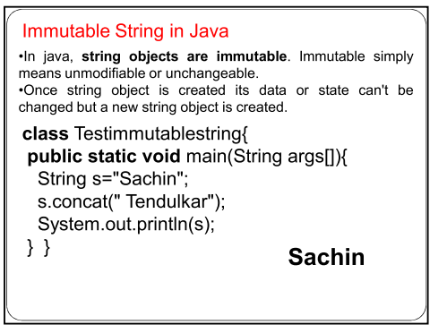

Slide 17
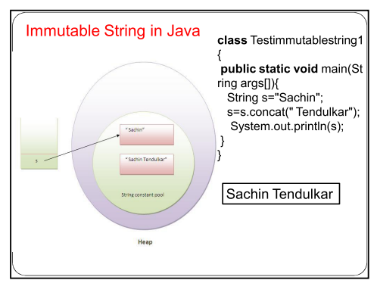

Slide 18
